Slide 1
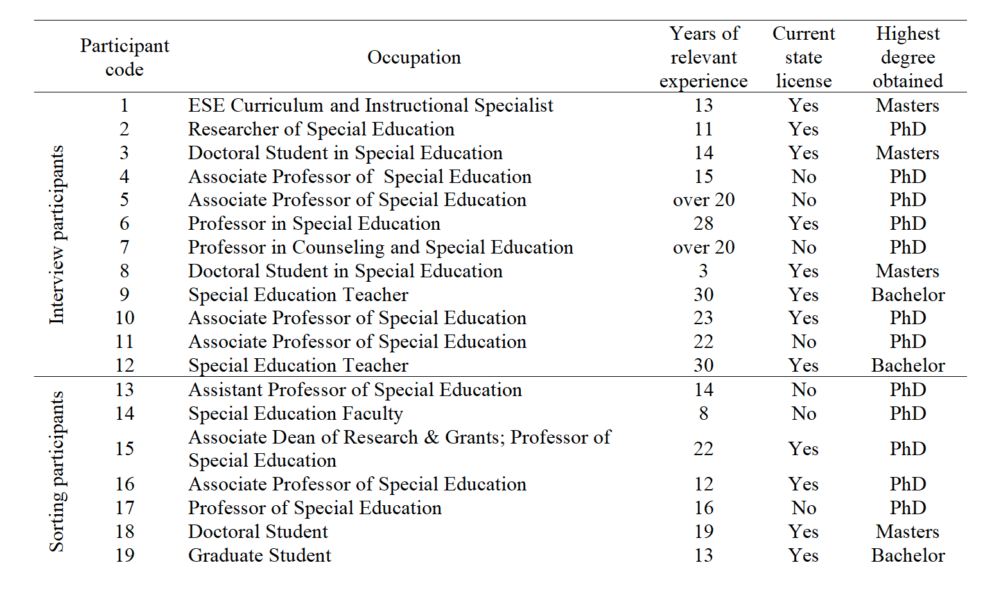
Scoring Tools to Assist the Development of Special Education Teacher
Presenter: Valeria Veras
Research Mentor : Addie McConomy
INTRODUCTION
METHODS
ABSTRACT
The project I have been working on under Addie is analyzing the different factors that will be taken into account in order to create a tool to assess special education teachers. The goal being to retain special education teachers and provide the opportunity for them to become better educators by using the assessment tool.
This topic of studying special education teachers is important due to the growing demand for teachers in the special education field. This study will lead to a hopeful retention of teachers and an increase in the quality of teaching As of 2016 there was information on assessment tools for general education teachers but lack of information on assessment tools for special education teachers. For this reason, this study is vital to the development and growth of special education. This study involved video interviews of experts in the special education field. My task was transcribing these videos and keeping the official record of data. This data will be put together to create the observing and assessment tool that will lead to developing better teachers. This research creates new resources and opportunities that will benefit educators and students.
The data collected in this project came from a series of interviews conducted over zoom by Addie McConomy. Addie McConomy interviewed various experts on the topic of Special Education. Specifically, gathering data on the relationship between high leverage practices and behaviors practiced by novice special education teachers. These zoom interviews where recorded and transcribed to allow members of the group to collect the data from the interviews. Each interview held a series of questions related to Special Education and several zoom group of interviewees had the same questions in order to gather various perspectives for more valuable information.
The data collected was analyzed after I, the UROP student went through each transcription and assured there where little to no mistakes to gather the most accurate data. These findings were gathered into different groups according to each question. These findings will lead to concepts on the scoring tool that will be used in a different part of the project.
These methods work for this project because it is so hingent on the experience of other people, particularly the Special Education experts. By using the carefully crafted questions to gather information and data from these experts, it will be the most efficient way to create an effective scoring tool that novice teachers will need to use in order to analyze their abilities in the classroom.
This data is mixed methods, the project begins by requiring the collection of qualitative data and ends by producing quantitative data, the research shows that teachers stay when they think they’re doing well so it is is important for the scoring tool to be effective because they want to retain teachers. Teachers will become better teachers as they asses themselves and then the test assesses them as well.
Over the past semester, I have been working with Addie McConomy on a project she has created to collect data from experts that are experienced in special education teaching, then use that information to create a scoring tool for novice special education teachers to analyze themselves in their classroom in hopes to increase the retention rate for novice special education teachers. A large sum of the data came for the video transcriptions of the experts interviewed, which I was tasked to go over with a fine tooth comb and correct any mistakes there may be so that Addie McConomy would have the most accurate data possible. Due to the circumstances also known as Covid 19, the interviews had to be done over zoom and zoom has automatic transcriptions. I was given a copy of the recorded video as well as the transcriptions and used both to carefully go over each transcription. This project has been set back due to Covid 19 and joining the Special Education teachers in the classroom has not been possible, so there are not clear conclusions thus far. The conclusions will come when the team is able to gather data and create the scoring tool. The scoring tool will be given to the educators and they will be able to self - analyze their abilities in the classroom and compare them to scores from observers. This will hopefully lead to constructive criticism that will positively impact the novice teachers as well as special education students.
DATA
DISCUSSION
PARTICPANT DATA AND EXAMPLES OF QUESTIONS AND RESPONSES IN INTERVIEW WITH SPECIAL EDUCTAION EXPERTS
Experts in the special education field have years of experience in classrooms with children who may need individualized instruction or a creative form of teaching. In the transcriptions collected you are able to see a trend in novice teachers and many of the unproductive behaviors come from not having the experience to understand how to cater to a student’s individual academic needs while also directing a whole class. The results that we currently have will be used to create the observational assessment that will emphasize specific points that novice teachers should be focusing on to be the most effective. These findings are important because the information collected to create this observational assessment will lead to a hopeful increase in the retention rate of novice teachers which will be beneficial for the students in these special education classes. The difficulty of education is always underestimated and the same thing goes for special education.
My research has shown me all the different aspects that go into not only teaching, but creating individualized plans for students while still maintaining a cohesive class unit. I see now that there are some things you will learn with experience and by collecting advice from experts in the field. The key to success comes from understanding the needs of each one of your students and every day reminding yourself that your priority is to make sure those needs are being met. There is a large sum of research left to be done to expand on the project. After this portion, there will be the gathering of all of the data we have and creating the observational assessment with it. After that the assessment will be used to analyze novice special education teachers, not to criticize them, but to give helpful advice that will give them motivation and creative ways to problem solve in hopes that the retention rate for novice teachers goes up.
Results
For the particular project I assisted in we used mixed methods, both qualitative and quantitative. The portion I worked on was transcribing video interviews in order to collect information from experts on the productive and non-productive behavior of novice special education teachers. Aside from the transcribing, Addie has been able to attain recorded classroom instruction from special education teachers in order to implement the scoring tool. These video lectures allow Addie McConomy to use her scoring tool to analyze the specific instruction that would benefit the most from this tool. This allowed Addie McConomy the liberty to continue her research despite restrictions from Covid- 19. Addie found that more data was needed, teacher interviews and lesson plans will be required to complete scoring of the High Leverage Practices.
REFERENCES
MeLeskey, J., Barringer, M-D., Billingsley, B., Brownell, M., Jackson, D., Kennedy, M., Lewis, T., Maheady, L., Rodriguez, J., Scheeler, M. C., Winn, J., & Ziegler, D. (2017, January). High-leverage practices in special education. Arlington, VA: Council for Exceptional Children & CEEDAR Center.
Snyder, R. A., & Pufpaff, L. A. (2021). Current state of high stakes teacher evaluation for special education teachers. The Journal of Special Education Apprenticeship, 10(1), 2.
Acknowledgments
I would like to share my appreciation for Ms. Addie McConomy for being there for me every step of the process through assisting her research and UROP as well.
I would also like to thank my UROP leaders, Alyssa and Lindsey for preparing us for our mentorship and research project presentations at this symposium.

